Slide 1


RPA| HYPERAUTOMATION | DOCUMENT UNDERSTANDING | PROCESS MINING |
^{MACHINE LEARNING & AI |} BUSINESS CASE & PILOT| CONSULTING
^{ADDRESS:}
^{Automatify AG}
^{Zwirnereistrasse22} ^{CH-8304Wallisellen}
^{CONTACT}
⁺⁴¹ ⁴³ ²³³⁰⁹⁰⁵
^{hello@automatify.ch}
^{www.automatify.ch}

Slide 2

WHO WE ARE
Swiss-Romanian company specialized in RPA and Intelligent Software Automation. For us – it’s a core competence, not a side project
We do end-to-end, consulting projects
We do business in Switzerland, and engineering in Romania
25 colleagues
Partners with UiPath, Automation Anywhere and Microsoft

Slide 3
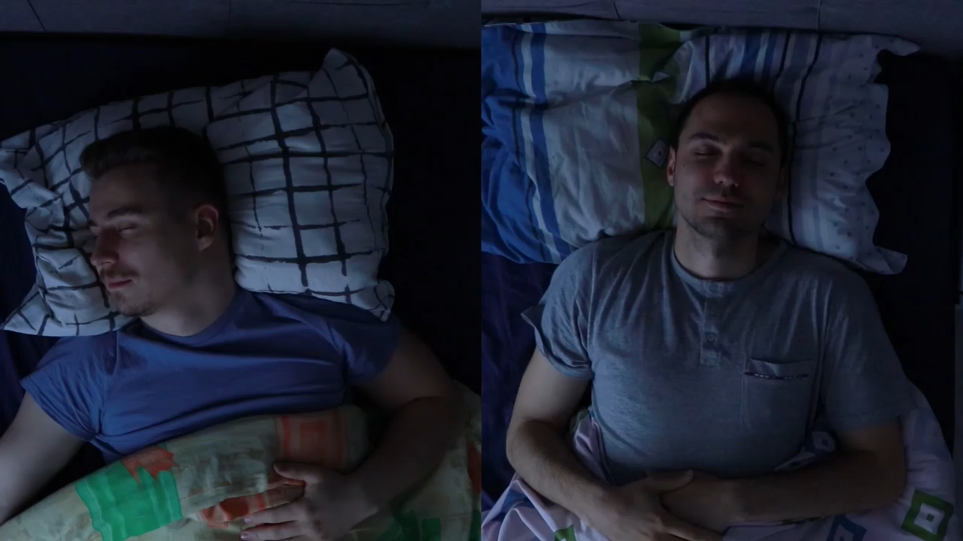

Slide 4




https://www.linkedin.com/company/automatify-ag/
https://www.facebook.com/automatifyag
Find us on:
https://www.instagram.com/automatifyag
https://www.tiktok.com/@automatify

Slide 5
THANK YOU

